Slide 1
COMP 3500 Introduction to Operating Systems Memory Management: Part 2
Dr. Xiao Qin
Auburn University http://www.eng.auburn.edu/~xqin
xqin@auburn.edu
Notes:
Spring’17
12b1: 10 Minutes. Review Memory Management Part 1
12b2: 40 Minutes. Memory Management Part 2. Slides 1-8
Fall’16
11a1-Memory Management Part 1 cont. : 25 Min (Fast Pace)
11a2-Memory Management Part 2: 25 Min (Fast Pace) Slides 1-17
11b: Slides 18-24.
Please review Chapters 8.1-8.5. In addition to reviewing lecture notes, you may refer to slides 1-48 here: ch8 Main Memory.ppt
A review session is scheduled on this Wednesday; midterm exam 2 is scheduled on this Friday.
Learning objectives of memory management:
To provide a detailed description of various ways of organizing memory hardware
To discuss various memory-management techniques, including paging and segmentation
To provide a detailed description of the Intel Pentium, which supports both pure segmentation and segmentation with paging

Slide 2
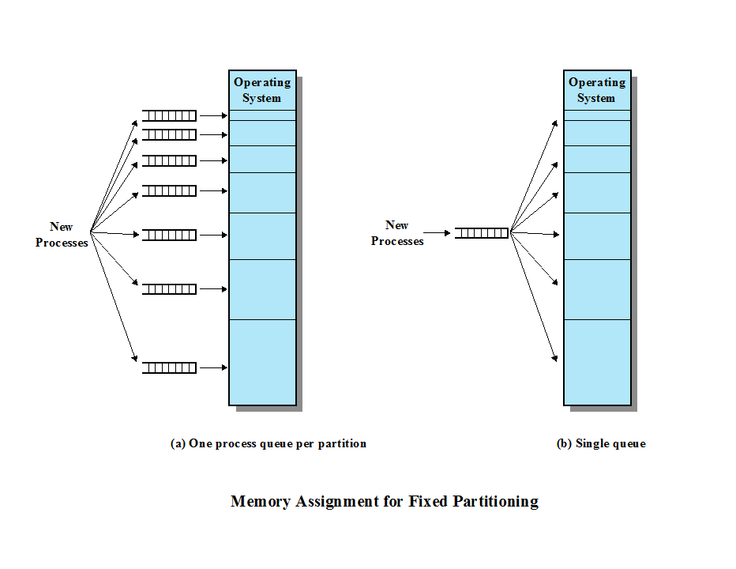
Exercise 5 (Plickers): Fixed Partitioning
Which design will you choose to implement? Why?
Wasted Memory?
Overall Performance?
Notes:
Question: Which one will you pick?
PLACEMENT ALGORITHM With equal-size partitions, the placement of processes in memory is trivial. As long as there is any available partition, a process can be loaded into that partition. Because all partitions are of equal size, it does not matter which partition is used. If all partitions are occupied with processes that are not ready to run, then one of these processes must be swapped out to make room for a new process. Which one to swap out is a scheduling decision; this topic is explored in Part Four.
With unequal-size partitions, there are two possible ways to assign processes to partitions. The simplest way is to assign each process to the smallest partition within which it will fit. In this case, a scheduling queue is needed for each partition, to hold swapped-out processes destined for that partition ( Figure 7.3a ). The advantage of this approach is that processes are always assigned in such a way as to minimize wasted memory within a partition (internal fragmentation).
Although this technique seems optimum from the point of view of an individual partition, it is not optimum from the point of view of the system as a whole. In Figure 7.2b , for example, consider a case in which there are no processes with a size between 12 and 16M at a certain point in time. In that case, the 16M partition will remain unused, even though some smaller process could have been assigned to it. Thus, a preferable approach would be to employ a single queue for all processes ( Figure 7.3b ). When it is time to load a process into main memory, the smallest available partition that will hold the process is selected. If all partitions are occupied, then a swapping decision must be made. Preference might be given to swapping out of the smallest partition that will hold the incoming process. It is also possible to consider other factors, such as priority, and a preference for swapping out blocked
processes versus ready processes.

Slide 3
Disadvantages of Fix Partitioning
The number of partitions specified at system generation time limits the number of active processes in the system
Small jobs will not efficiently utilize partition space
Notes:
The use of unequal-size partitions provides a degree of flexibility to fixed partitioning. In addition, it can be said that fixed-partitioning schemes are relatively simple and require minimal OS software and processing overhead. However, there are disadvantages:
• The number of partitions specified at system generation time limits the number of active (not suspended) processes in the system.
• Because partition sizes are preset at system generation time, small jobs will not utilize partition space efficiently. In an environment where the main storage requirement of all jobs is known beforehand, this may be reasonable, but in most cases, it is an inefficient technique.

Slide 4
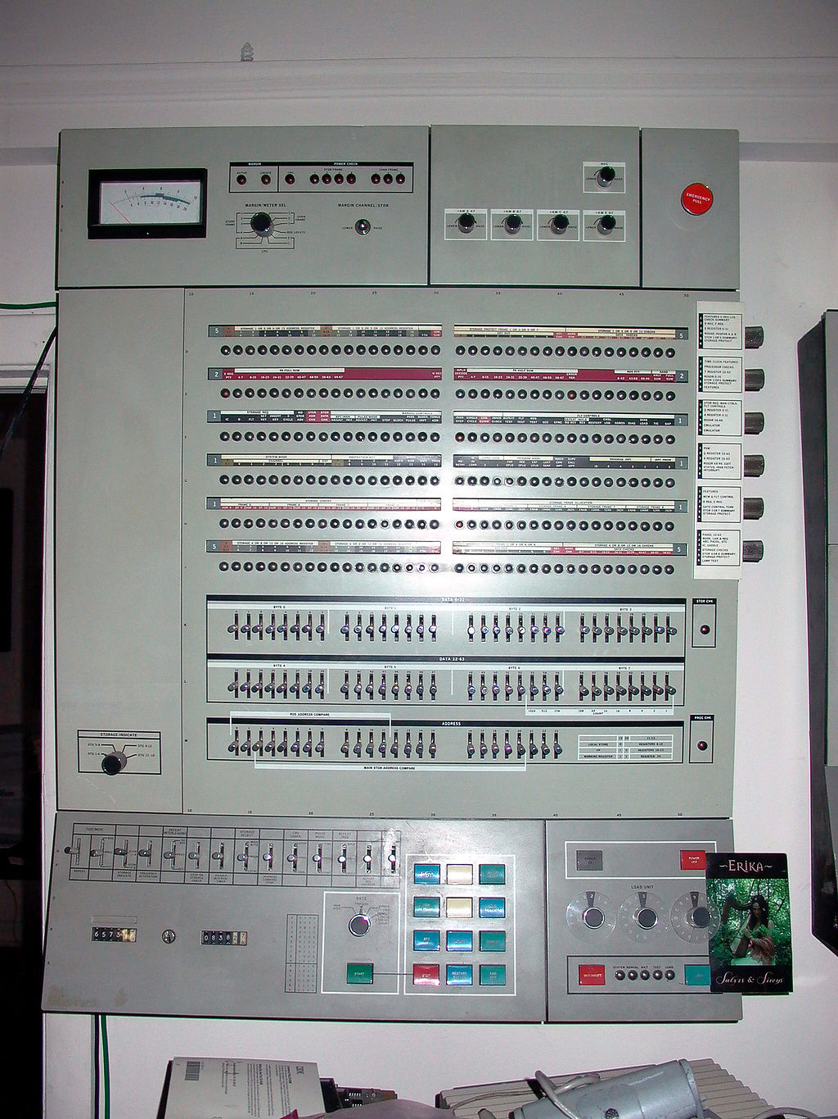
Dynamic Partitioning
Partitions are of variable length and number
Process is allocated exactly as much memory as it requires
This technique was used by IBM’s mainframe operating system, OS/MVT
Notes:
To overcome some of the difficulties with fixed partitioning, an approach known as dynamic partitioning was developed. Again, this approach has been supplanted by more sophisticated memory management techniques. An important operating system that used this technique was IBM’s mainframe operating system, OS/MVT (Multiprogramming with a Variable Number of Tasks).
With dynamic partitioning, the partitions are of variable length and number. When a process is brought into main memory, it is allocated exactly as much memory as it requires and no more.
OS/360, officially known as IBM System/360 Operating System,[1][2] is a discontinued batch processing operating system developed by IBM for their then-new System/360 mainframe computer, announced in 1964; it was heavily influenced by the earlier IBSYS/IBJOB and Input/Output Control System (IOCS) packages. It was among the earliest operating systems to make direct access storage devices a prerequisite for their operation.
Multiprogramming with a Variable number of Tasks (MVT)[14] was the most sophisticated of three available configurations of OS/360's control program.[2] MVT was intended for the largest machines in the System/360 family. Introduced in 1964, it did not become available until 1967. Early versions had many problems and the simpler MFT continued to be used for many years.

Slide 5
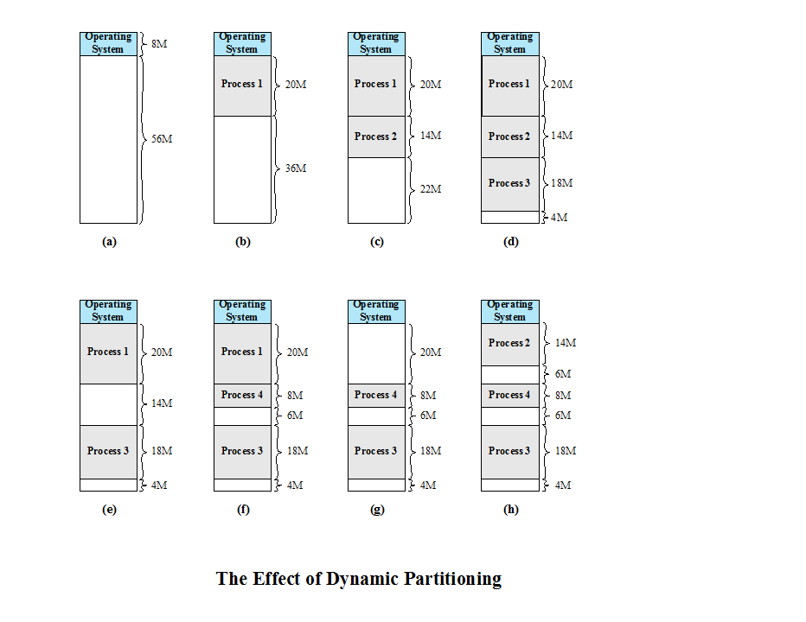
Exercise 6 (Plickers): What is a problem with dynamic partitioning?
A. Flexibility
B. Internal fregmentation
C. Small holes
D. All the above
Notes:
An example, using 64 Mbytes of main memory. Initially, main memory is empty, except for the OS (a). The first three processes are loaded in, starting where the operating system ends and occupying just enough space for each process (b, c, d). This leaves a “hole” at the end of memory that is too small for a fourth process. At some point, none of
the processes in memory is ready. The operating system swaps out process 2 (e), which leaves sufficient room to load a new process, process 4 (f). Because process 4 is smaller than process 2, another small hole is created. Later, a point is reached at which none of the processes in main memory is ready, but process 2, in the Ready-Suspend state, is available. Because there is insufficient room in memory for process 2, the operating system swaps process 1 out (g) and swaps process 2 back in (h).
Problem: As this example shows, this method starts out well, but eventually it leads to a situation in which there are a lot of small holes in memory. As time goes on, memory becomes more and more fragmented, and memory utilization declines. This phenomenon is referred to as external fragmentation , indicating that the memory that is external to all partitions becomes increasingly fragmented. This is in contrast to internal fragmentation, referred to earlier.

Slide 6
Question: What is a solution to the fragmentation problem?
External Fragmentation
memory becomes more and more fragmented
memory utilization declines
Compaction
technique for overcoming external fragmentation
OS shifts processes so that they are contiguous
free memory is together in one block
time consuming and wastes CPU time (Why?)
Notes:
One technique for overcoming external fragmentation is compaction : From time to time, the OS shifts the processes so that they are contiguous and so that all of the free memory is together in one block. For example, in Figure 7.4h , compaction will result in a block of free memory of length 16M. This may well be sufficient to load in an additional process. The difficulty with compaction is that it is a time-consuming procedure and wasteful of processor time. Note that compaction implies the need for a dynamic relocation capability. That is, it must be possible to move a program from one region to another in main memory without invalidating the memory references in the program (see Appendix 7A).

Slide 7
Placement Algorithms
Best-fit
chooses the block that is closest in size to the request
First-fit
begins to scan memory from the beginning and chooses the first available block that is large enough
Next-fit
begins to scan memory from the location of the last placement and chooses the next available block that is large enough
Notes:
Because memory compaction is time consuming, the OS designer must be clever in deciding how to assign processes to memory (how to plug the holes). When it is time to load or swap a process into main memory, and if there is more than one free block of memory of sufficient size, then the operating system must decide which free block to allocate.
Three placement algorithms that might be considered are best-fit, first-fit, and next-fit. All, of course, are limited to choosing among free blocks of main memory that are equal to or larger than the process to be brought in. Best-fit chooses the block that is closest in size to the request. First-fit begins to scan memory from the beginning and chooses the first available block that is large enough. Next-fit begins to scan memory from the location of the last placement, and chooses the next available block that is large enough.

Slide 8
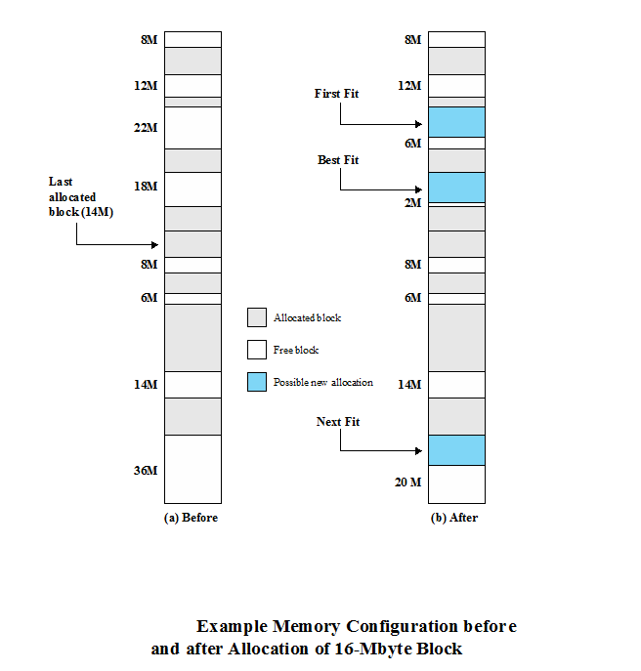
Exercise 7: Which slot do Best-Fit, First-Fit, and Next-Fit allocate for 16-MB block?
Notes:
Figure 7.5a shows an example memory configuration after a number of placement and swapping-out operations. The last block that was used was a 22-Mbyte block from which a 14-Mbyte partition was created. Figure 7.5b shows the difference between the best-, first-, and next-fit placement algorithms in satisfying a 16-Mbyte allocation request. Best-fit will search the entire list of available blocks and make use of the 18-Mbyte block, leaving a 2-Mbyte fragment. First-fit results in a 6-Mbyte fragment, and next-fit results in a 20-Mbyte fragment.
Which of these approaches is best will depend on the exact sequence of process swapping that occurs and the size of those processes. However, some general comments can be made (see also [BREN89], [SHOR75], and [BAYS77]). The first-fit algorithm is not only the simplest but usually the best and fastest as well. The next-fit algorithm tends to produce slightly worse results than the first-fit. The next-fit algorithm will more frequently lead to an allocation from a free block at the end of memory. The result is that the largest block of free memory, which usually appears at the end of the memory space, is quickly broken up into small fragments. Thus, compaction may be required more frequently with next-fit. On the other hand, the first-fit algorithm may litter the front end with small free partitions that need to be searched over on each subsequent first-fit pass. The best-fit algorithm, despite its name, is usually the worst performer. Because this algorithm looks for the smallest block that will satisfy the requirement, it guarantees that the fragment left behind is as small as possible. Although each memory request always wastes the smallest amount of memory, the result is that main memory is quickly littered by blocks too small to satisfy memory allocation requests. Thus, memory compaction must be done more frequently than with the other algorithms.

Slide 9
Buddy System
Comprised of fixed and dynamic partitioning schemes
Space available for allocation is treated as a single block
Memory blocks are available of size 2^{K} words, L ≤ K ≤ U, where
2^{L} = smallest size block that is allocated
2^{U} = largest size block that is allocated; generally 2^{U} is the size of the entire memory available for allocation
Notes:
Let’s pass this topic to save time.
Both fixed and dynamic partitioning schemes have drawbacks. A fixed partitioning scheme limits the number of active processes and may use space inefficiently if there is a poor match between available partition sizes and process sizes. A dynamic partitioning scheme is more complex to maintain and includes the overhead of compaction. An interesting compromise is the buddy system ([KNUT97], [PETE77]).
Memory blocks are available of size 2^{K} words, L ≤ K ≤ U, where
2^{L} = smallest size block that is allocated
2^{U} = largest size block that is allocated; generally 2^{U} is the size of the entire memory available for allocation
To begin, the entire space available for allocation is treated as a single block of size 2^{U} . If a request of size s such that 2^{U –1} ≤ s 2^{U} is made, then the entire block is allocated. Otherwise, the block is split into two equal buddies of size 2^{U –1} . If 2^{U –2 ≤} ≤ s 2^{U –1} , then the request is allocated to one of the two buddies. Otherwise, one of the buddies is split in half again. This process continues until the smallest block greater than or equal to s is generated and allocated to the request. At any time, the buddy system maintains a list of holes (unallocated blocks) of each size 2 ^{i} . A hole may be removed from the ( i + 1) list by splitting it in half to create two buddies of size 2 ^{i} in the i list. Whenever a pair of buddies on the i list both become unallocated, they are removed from that list and coalesced into a single block on the ( i + 1) list.

Slide 10
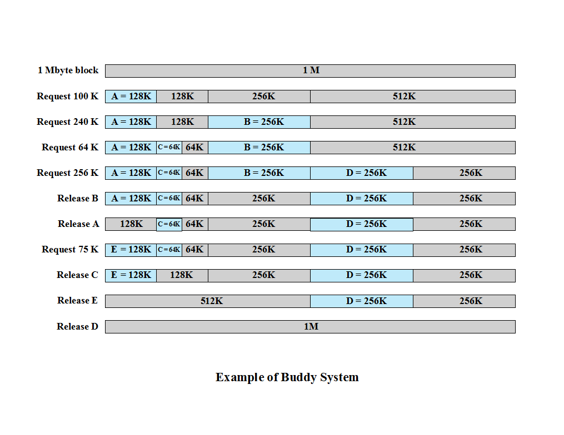
Notes:
Figure 7.6 gives an example using a 1-Mbyte initial block. The first request, A, is for 100 Kbytes, for which a 128K block is needed. The initial block is divided into two 512K buddies. The first of these is divided into two 256K buddies, and the first of these is divided into two 128K buddies, one of which is allocated to A. The next request, B, requires a 256K block. Such a block is already available and is allocated. The process continues with splitting and coalescing occurring as needed. Note that when E is released, two 128K buddies are coalesced into a 256K block, which is immediately coalesced with its buddy.

Slide 11
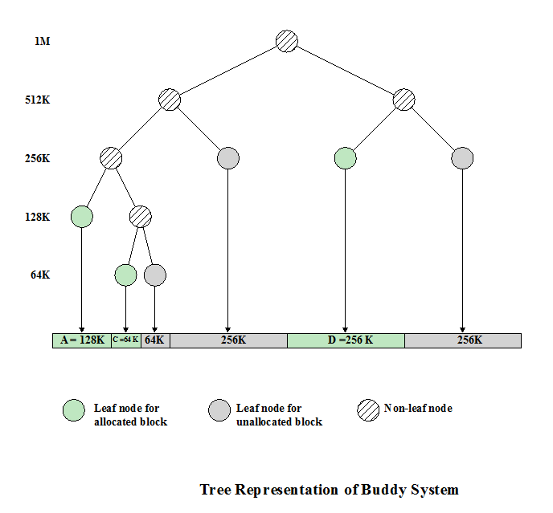
Notes:
Figure 7.7 shows a binary tree representation of the buddy allocation immediately after the Release B request. The leaf nodes represent the current partitioning of the memory. If two buddies are leaf nodes, then at least one must be allocated; otherwise they would be coalesced into a larger block.
The buddy system is a reasonable compromise to overcome the disadvantages of both the fixed and variable partitioning schemes, but in contemporary operating systems, virtual memory based on paging and segmentation is superior. However, the buddy system has found application in parallel systems as an efficient means of allocation and release for parallel programs (e.g., see [JOHN92]). A modified form of the buddy system is used for UNIX kernel memory allocation (described in Chapter 8 ).

Slide 12
Addresses
Logical
reference to a memory location independent of the current assignment of data to memory
Relative
address is expressed as a location relative to some known point
Physical or Absolute
actual location in main memory
Notes:
A logical address is a reference to a memory location independent of the current assignment of data to memory; a translation must be made to a physical address before the memory access can be achieved. A relative address is a particular example of logical address, in which the address is expressed as a location relative to some known point, usually a value in a processor register. A physical address , or absolute address, is an actual location in main memory.

Slide 13
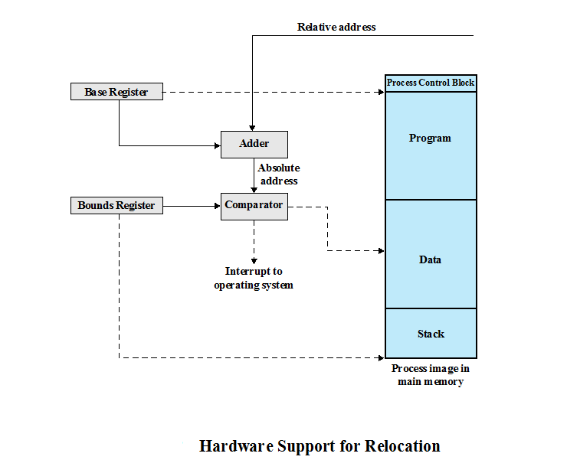
Notes:
Programs that employ relative addresses in memory are loaded using dynamic run-time loading (see Appendix 7A for a discussion). Typically, all of the memory references in the loaded process are relative to the origin of the program. Thus a hardware mechanism is needed for translating relative addresses to physical main memory addresses at the time of execution of the instruction that contains the reference.
Figure 7.8 shows the way in which this address translation is typically accomplished. When a process is assigned to the Running state, a special processor register, sometimes called the base register, is loaded with the starting address in main memory of the program. There is also a “bounds” register that indicates the ending location of the program; these values must be set when the program is loaded into memory or when the process image is swapped in. During the course of execution of the process, relative addresses are encountered. These include the contents of the instruction register, instruction addresses that occur in branch and call instructions, and data addresses that occur in load and store instructions. Each such relative address goes through two steps of manipulation by the processor. First, the value in the base register is added to the relative address to produce an absolute address. Second, the resulting address is compared to the value in the bounds register. If the address is within bounds, then the instruction execution may proceed. Otherwise, an interrupt is generated to the operating system, which must respond to the error in some fashion.
The scheme of Figure 7.8 allows programs to be swapped in and out of memory during the course of execution. It also provides a measure of protection: Each process image is isolated by the contents of the base and bounds registers and safe from unwanted accesses by other processes.

Slide 14
Paging
Partition memory into equal fixed-size chunks that are relatively small
Process is also divided into small fixed-size chunks of the same size
Pages
chunks of a process
Frames
available chunks of memory
Notes:
Both unequal fixed-size and variable-size partitions are inefficient in the use of memory; the former results in internal fragmentation, the latter in external fragmentation. Suppose, however, that main memory is partitioned into equal fixed-size chunks that are relatively small, and that each process is also divided into small fixed-size chunks of the same size. Then the chunks of a process, known as pages , could be assigned to available chunks of memory, known as frames , or page frames. We show in this section that the wasted space in memory for each process is due to internal fragmentation consisting of only a fraction of the last page of a process. There is no external fragmentation.

Slide 15
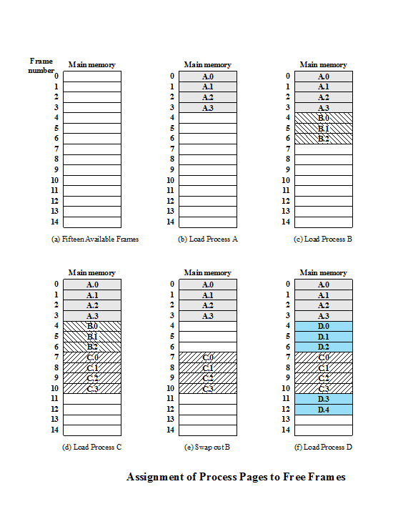

Slide 16
Page Table
Maintained by operating system for each process
Contains the frame location for each page in the process
Processor must know how to access for the current process
Used by processor to produce a physical address
Notes:
A simple base address register will no longer suffice. Rather, the operating system maintains a page table for each process. The page table shows the frame location for each page of the process. Within the program, each logical address consists of a page number and an offset within the page. Recall that in the case of simple partition, a logical address is the location of a word relative to the beginning of the program; the processor translates that into a physical address. With paging, the logical-to-physical address translation is still done by processor hardware. Now the processor must know how to access the page table of the current process. Presented with a logical address (page number, offset), the processor uses the page table to produce a physical address (frame number, offset).

Slide 17
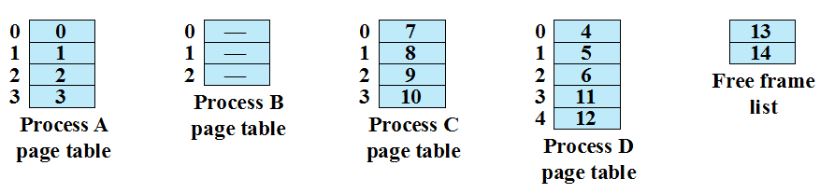
Exercise 8: Page Table: An Example @ time (f)
Notes:
Page Table Examples

Slide 18
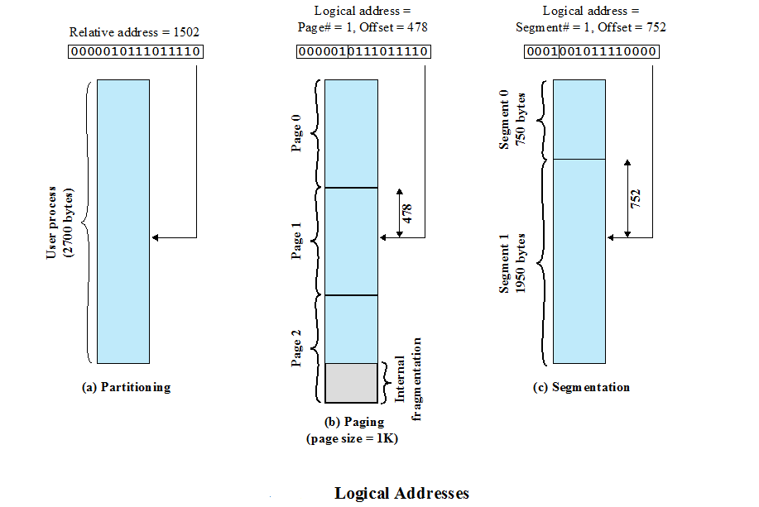

Slide 19
Examples of Logical-to-Physical Address Translation

Slide 20
Segmentation
A program can be subdivided into segments
may vary in length
there is a maximum length
Addressing consists of two parts:
segment number
an offset
Similar to dynamic partitioning
Eliminates internal fragmentation
Notes:
A user program can be subdivided using segmentation, in which the program and its associated data are divided into a number of segments . It is not required that all segments of all programs be of the same length, although there is a maximum segment length. As with paging, a logical address using segmentation consists of two parts, in this case a segment number and an offset.
Because of the use of unequal-size segments, segmentation is similar to dynamic partitioning. In the absence of an overlay scheme or the use of virtual
memory, it would be required that all of a program’s segments be loaded into memory for execution. The difference, compared to dynamic partitioning, is that with segmentation a program may occupy more than one partition, and these partitions need not be contiguous. Segmentation eliminates internal fragmentation but, like dynamic partitioning, it suffers from external fragmentation. However, because a process is broken up into a number of smaller pieces, the external fragmentation should be less.

Slide 21
Segmentation
Usually visible
Provided as a convenience for organizing programs and data
Typically the programmer will assign programs and data to different segments
For purposes of modular programming the program or data may be further broken down into multiple segments
Question: Why the programmer must be aware of the maximum segment size limitation?
Notes:
Whereas paging is invisible to the programmer, segmentation is usually visible
and is provided as a convenience for organizing programs and data. Typically, the
programmer or compiler will assign programs and data to different segments. For
purposes of modular programming, the program or data may be further broken down
into multiple segments. The principal inconvenience of this service is that the programmer
must be aware of the maximum segment size limitation.
the principal inconvenience of this service is that the programmer must be aware of the maximum segment size limitation

Slide 22
Address Translation
Another consequence of unequal size segments is that there is no simple relationship between logical addresses and physical addresses
The following steps are needed for address translation:
Extract the segment number as the leftmost n bits of the logical address
Use the segment number as an index into the process segment table to find the starting physical address of the segment
Compare the offset, expressed in the rightmost m bits, to the length of the segment. If the offset is greater than or equal to the length, the address is invalid
The desired physical address is the sum of the starting physical address of the segment plus the offset
Notes:
Another consequence of unequal-size segments is that there is no simple relationship
between logical addresses and physical addresses. Analogous to paging, a
simple segmentation scheme would make use of a segment table for each process
and a list of free blocks of main memory. Each segment table entry would have to
give the starting address in main memory of the corresponding segment. The entry
should also provide the length of the segment to assure that invalid addresses are
not used. When a process enters the Running state, the address of its segment table is
loaded into a special register used by the memory management hardware.
Consider an address of n + m bits, where the leftmost n bits are the segment number and the
rightmost m bits are the offset. In our example (Figure 7.11c), n = 4 and m = 12.
Thus the maximum segment size is 212 = 4096. The following steps are needed for
address translation:
• Extract the segment number as the leftmost n bits of the logical address.
• Use the segment number as an index into the process segment table to find the
starting physical address of the segment.
• Compare the offset, expressed in the rightmost m bits, to the length of the segment.
If the offset is greater than or equal to the length, the address is invalid.
• The desired physical address is the sum of the starting physical address of the
segment plus the offset.

Slide 23
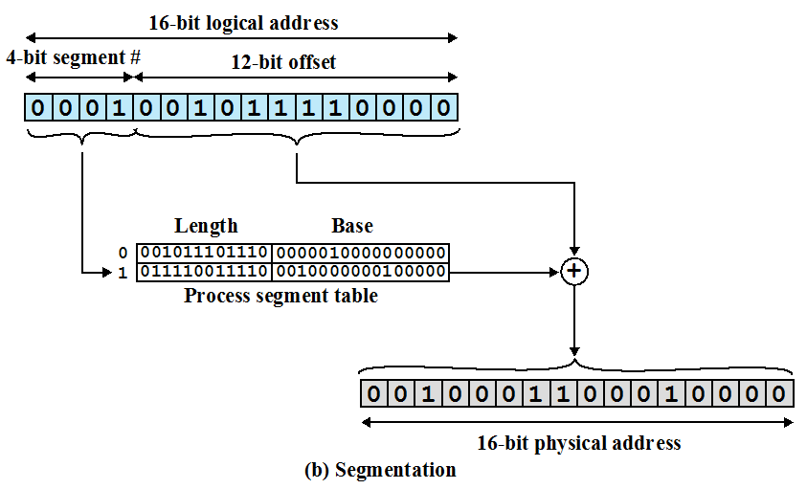
Examples of Logical-to-Physical Address Translation

Slide 24
Summary
Dynamic Partitioning
Buddy System
Logical-to-Physical Address Translation
Segmentation

